Slide 1
R shiny app
31 March 2022
https://chenlabgccri.shinyapps.io/DepLink/

Slide 2
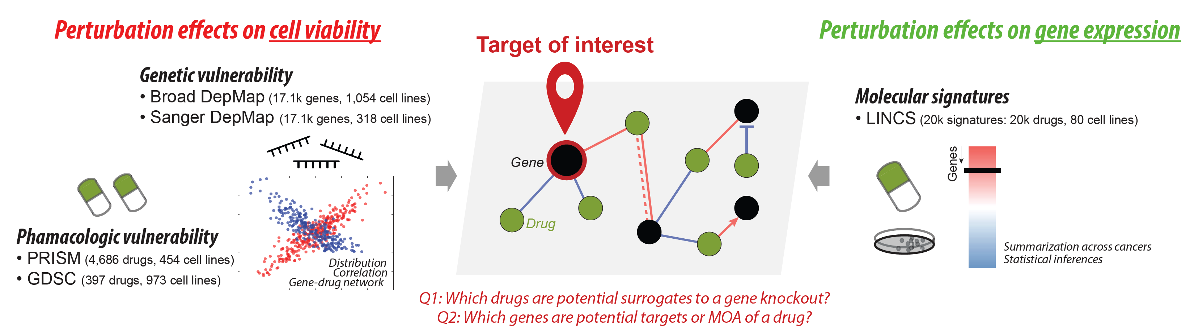
What is DepLink?
R Shiny app that systematically links genetic and pharmacologic dependencies of cancer.
Identifies genetic perturbations (gene knockouts) and pharmacologic perturbations (drug treatments) that induce similar changes in cancer cell viability or gene expression profiles.
How does it help?
Find drugs that are potential surrogates to gene knockouts in cancer cell
Find genes that are potential targets or mechanisms of action (MOA) of a drug
Notes:
-DepLink analyses datasets where perturbation effects on cell viability and gene expression profiles. This is achieved two ways (1) genetic vulnerabilities (CRISPR screen data), (2) Pharmacological vulnerability and (3) Molecular perturbation signatures.
- This helps different query scenarios to identify potential druggable vulnerabilities and understand mechanisms of action of known drugs and new drugs

Slide 3
Gene Perturbations
Datasets (after preprocessing):
Drug Perturbations
1. DepMap Broad dataset
21Q4
CRISPR knockout screens
Gene Effect (dependency scores)
17,078 gene x 1054 cell lines
2. Sanger dataset
2019, v2
CRISPR knockout screens
Gene Effect (dependency scores)
17,078 gene x 318 cell lines
1. Primary PRISM repurposed
19Q4
Small molecule viable datasets
Logfold change values
4686 drugs x 568 cell lines
2. Sanger GDSC dataset
2019, GDSC 1 and GDSC 2
Drug response IC50
287 drugs x 973 cell lines
3. LINCS
Phase I molecular signatures by Broad Institute
Public on Mar 03, 2017
12328 genes x 19811 signatures
Common Genes
Common Drugs
Broad
Sanger
Prism
GDSC
380
17078
308
4479
205
82
29 different cancer types in cell lines

Slide 4
Four Functional Modules
Module 1: Query a Gene
Query a gene and search for drug treatments that induce similar inhibitory effects on cell viability.
Inputs: 1. Gene Name
2. PanCan type
Outputs: 1. Dependency scores data summary (data distribution, box plots)
2. Gene-Gene correlations i.e., positive or negative correlations of gene loss-of-function (density plots, table, visual network )
3. Gene-Drug correlations i.e., similarities to cell viability (density plots, table, visual networks)
Module 2: Query a Gene List (LINCS dataset)
Identify a drug that perturbs, either positively or negatively, query genes.
Inputs: 1. List of Gene Names
2. Choice ‘Upregulated’ or ‘Downregulated’
Outputs: 1. Density plot of gene dependency scores
2. Table of drugs perturbing query genes
Module 3: Query a Drug
Query a drug and search for gene knockouts that induce similar inhibitory effects on cell viability.
Inputs: 1. Drug Name
2. PanCan type
3. Data source prompt
Outputs: 1. Logfold change / IC50 data summary (data distribution, box plots)
2. Drug-Drug correlations i.e., similar drug response to cell line viabilities(density plots, table, visual network )
3. Drug-Gene correlations (density plots, table, visual networks)
Module 4: Query a New Drug (PRISM dataset)
Query SMILES code of a new drug and identify similar know drugs based on similarity of biochemical features.
Inputs: 1. Drug SMILES code
Outputs: 1. 2D drug structure (Drug fingerprint, 'pubchem', 'maccs') )
2. Tanimoto similarity index (Venn Diagram, Table)
3. T-SNE plot, provides drug structure similarities among remaining PRISM drugs

Slide 5
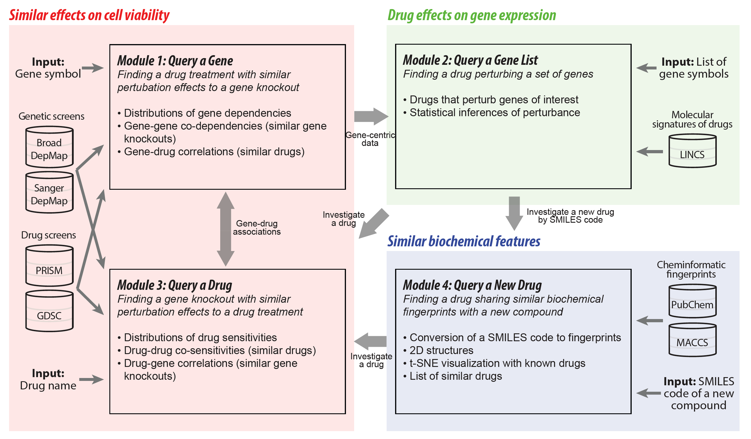
Four Functional Modules

Slide 6
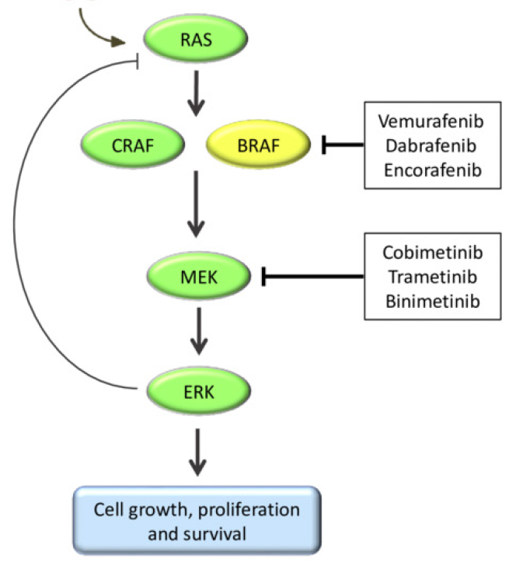
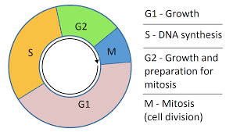
Used Case: Query Drug CDK6
Activation of cyclin-dependent kinases (CDKs) promote cell-cycle progression, and its dysregulation the main reason for cancer as a pathological process.
CDK4/6 inhibitors cancer drugs are designed to inhibit cell proliferation in tumor types where CDK4/6 inhibitors has a pivotal role in the G₁ to S phase of cell-cycle transition.
Advanced stage oestrogen receptor (ER)-positive breast cancer.
The MAPK (mitogen-activated protein kinase) pathway is a tightly regulated signaling for cell cycle frequently mutated or deregulated in cancer.
A MEK inhibitor is a chemical or drug that inhibits the mitogen-activated protein kinase enzymes MEK1 and/or MEK2.
Mutations in both KRAS and BRAF genes have been identified in non-small cell lung cancer (NSCLC)
The MAPK signaling pathway and targeted drugs
HRAS, NRAS, KRAS
ARAF, BRAF, CRAF
MEK inhibitors
MAP2K1, MAP2K2
Cell cycle
MAPK1, MAPK3
CDK inhibitors
Palbocicilib
Ribociclib
Abemaciclib
Cyclin D, CDK 4/6
Notes:
- Activating mutations in the MAPK pathway, which incorporates the enzymes RAS (RAS, encoded by HRAS, NRAS, and KRAS), RAF (encoded by ARAF, BRAF, and
CRAF), MEK (encoded by MAP2K1 and MAP2K2), and ERK (encoded by MAPK1 and MAPK3), results in constitutive signaling, leading to oncogenic cell proliferation
and escape from apoptosis

Slide 7
Used Case (Module 1 and 3): Query Drug CDK 6

Slide 8
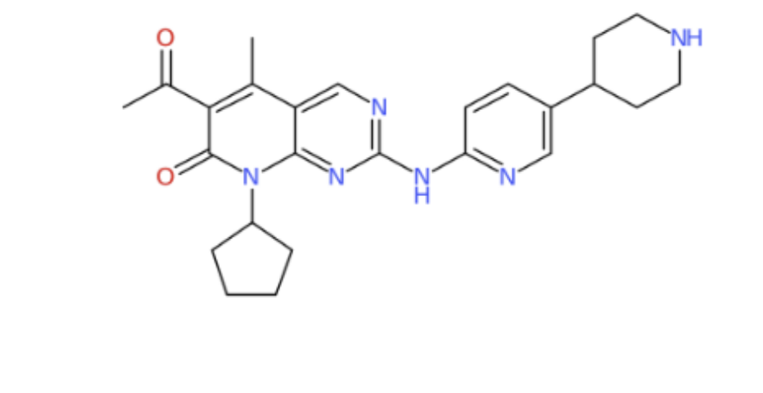
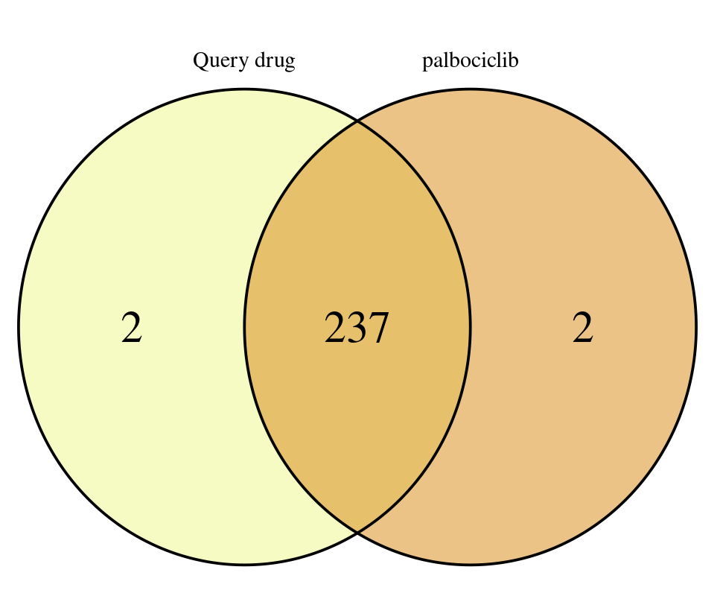
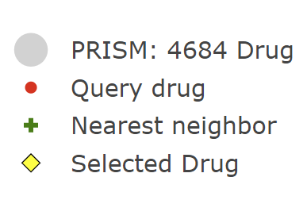
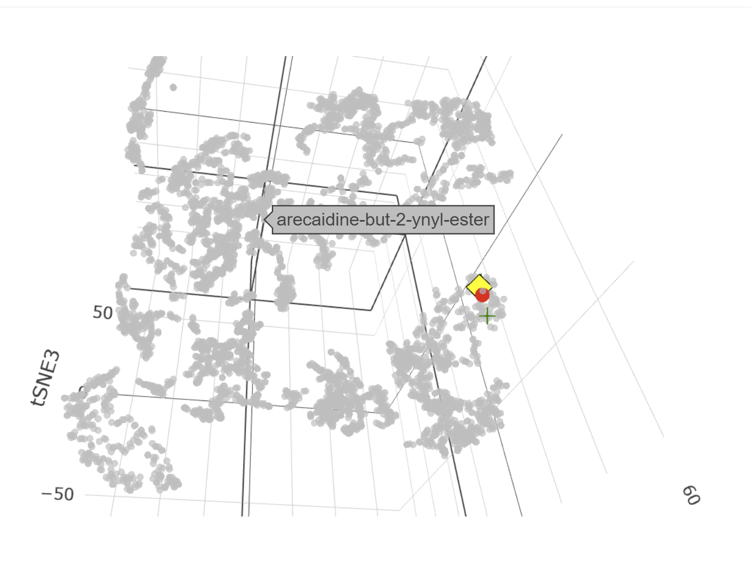
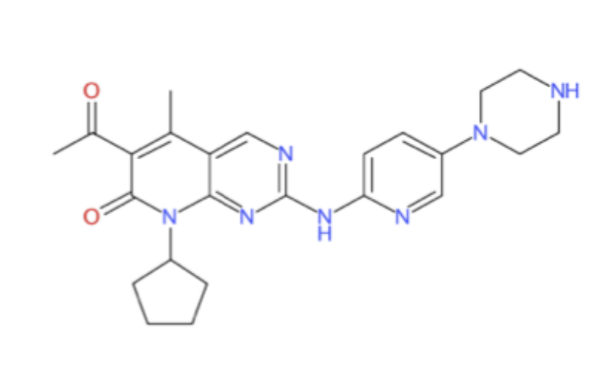
Used Case (Module 4): New Drug
Drug ‘SHR6390’ a CDK4/6 inhibitor developed by Chinese pharmaceutical company Jiangsu Hengrui Medicine
SMILES (Simplified Molecular-Input Line-Entry System) code:
CC1=C(C(=O)N(C2=NC(=NC=C12)NC3=NC=C(C=C3)C4CCNCC4)C5CCCC5)C(=O)C
SHR-6390
Palbocicilib
Tanimoto score = 0.963

Slide 9
Used Case: Query Drug CDK 6
ρ = 0.576
Notes:
Study cell viability inhibition using CDK6 knockout
Identify drugs that perturb CDK6 together with other cell cycle genes
Gene-effect scores (less than -1) indicates essentiality of CDK6 on cell lines, particulary in Leukemia, Mylenoma, Neuroblastoma.
Pearson Correlation between CDK6 and PRISM drugs was computed, displayed top 10. Two groups
CDK4/6 inhibitors, Palbociclib and robocicilib. Drugs approved for breast cancer
MEK inhibitors, Cobimetinib FDA approved for melanoma
MOAs of these drugs, we identified top 10 correlated genes to each of the 10 drugs correlated to CDK6 knockout and incorporated
Both CDK and MEK inhibitors are known for cell cycle inhibition

